Slide 1
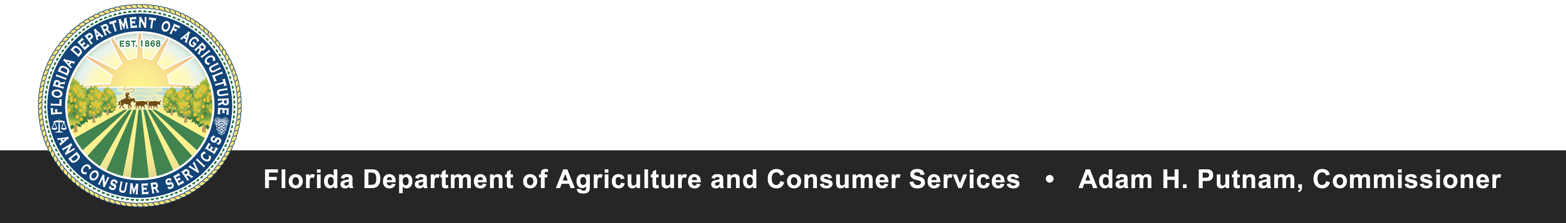
Division of Aquaculture
Jill Fleiger
Environmental Administrator
600 S Calhoun Street, Suite 217
Tallahassee, FL, 32311
850-617-7600

Slide 2
Outline
The Division’s program areas
Background to the National Shellfish Sanitation Program
Shellfish Classification Program Goals
Process of reclassifying harvest areas and water quality monitoring
Past management and classification of Duval harvest area

Slide 3
What do we do?
Classify and Manage Shellfish Harvesting areas throughout the state
Inspect shellfish processing facilities
Administer Submerged Land Lease Program as staff to the Governor and Cabinet
Administer the Aquaculture Certification and Best Management Practices for Aquaculture

Slide 4
National Shellfish Sanitation Program
A federal/state cooperative program collaborating with the Food and Drug Administration (FDA) and the Interstate Shellfish Sanitation Program (ISSC) for the sanitary control of shellfish produced and sold for human consumption
NSSP Model ordinance drives policy and decision making at the state level
  Purpose is to promote and improve sanitation of shellfish moving in interstate commerce through federal/state cooperation and uniformity of State Shellfish Programs
  Components include: program guidelines, state growing area classification and dealer certification programs, and FDA evaluation of State Program elements

Slide 5
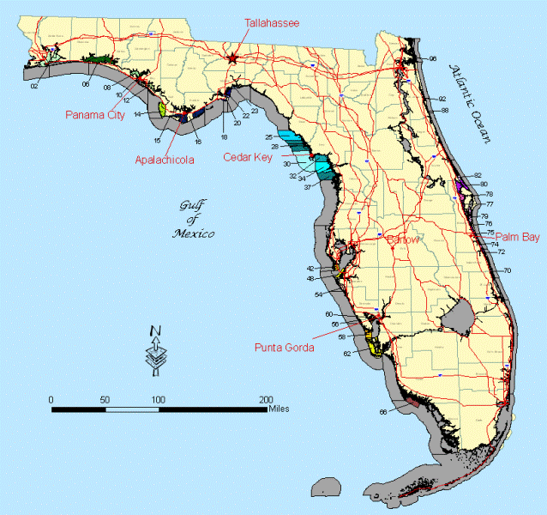
Florida’s Shellfish Harvesting Areas

Slide 6
Shellfish Harvesting Area
Classification Program (SHAC)
Management decision are based solely on Public Health Protection
Responsible for the active management of SHAs and the collection of water and meat samples
Goal is to provide maximum utilization of shellfish resources and to reduce the risk of shellfish-borne illness
All samples must be analyzed by an FDA approved lab – The lab is located at the FDACS Shellfish Center located in Apalachicola, Florida

Slide 7
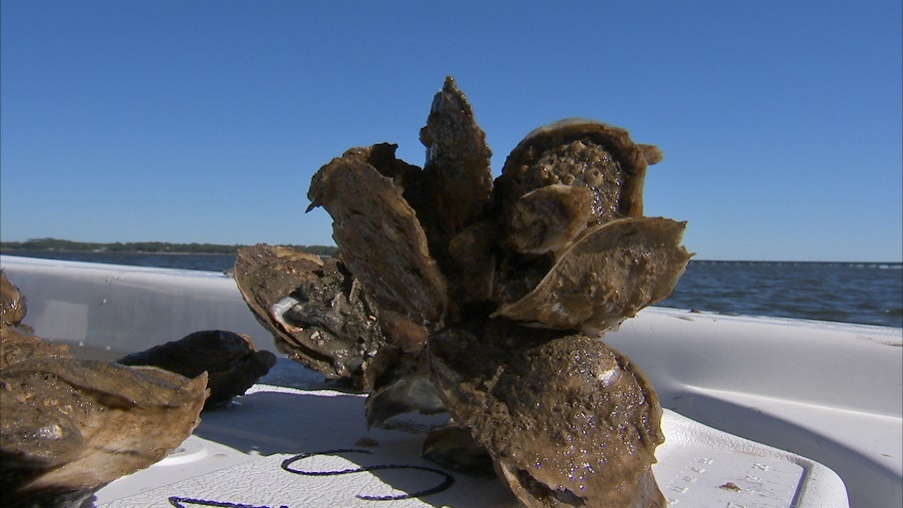
Process of Classifying a
Shellfish Harvest Area
Conduct a shoreline survey of area
  Identifies point and non-point sources of pollution throughout harvest area
Set water quality monitoring stations
Collect an N of 30 sample dates
Collect hydrological data (ie. Rainfall, River Stage/Discharge and)
Notes:
Non point and point sources include:
Wastewater treatment plants, septic tanks, runoff, wildlife, industrial waste, boats, marinas

Slide 8
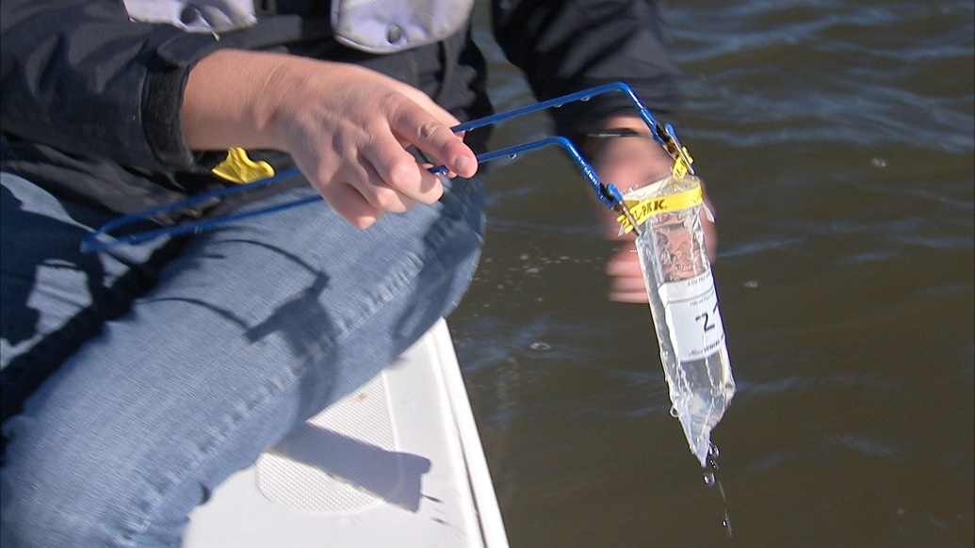
Process of (re)Classifying
Shellfish Harvest Areas
Data Analysis using SAS software to determine correlation between hydrological data (Rainfall, River stage or discharge) and fecal coliform
Write area survey with, sanitary survey summary, data analysis classification boundaries and management plans

Slide 9
Classifications
Approved – always open to harvest except under emergency conditions (ie Tropical Storms, Hurricanes, Sewage Spills, and Marine Biotoxins).
Conditionally Approved – meets approved status except under conditions outlined in the management plan. (ie Rain events, elevated river levels, marine biotoxins). Has intermittent microbiological pollution.
Prohibited – does not meet water quality standards for harvesting.
Unclassified – No sanitary survey exists. Harvesting prohibited

Slide 10
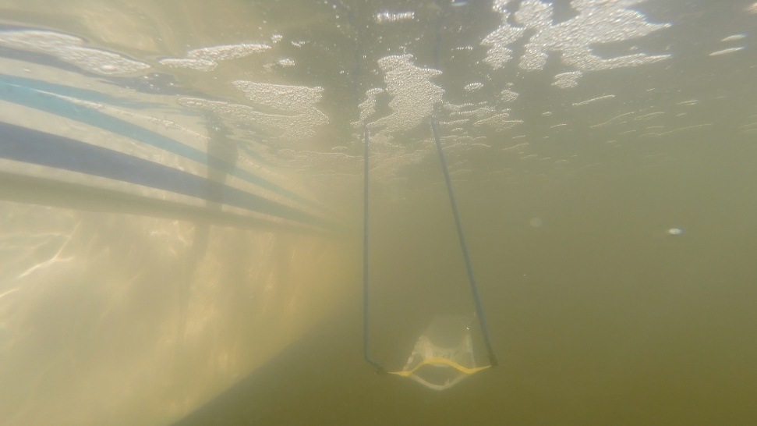
How do we monitor water quality?
Fixed Stations are monitored throughout the areas at pollution sources, sources of freshwater (rivers and creeks), and on oyster bars
Water samples are collected just below the surface
Water samples are analyzed for Fecal Coliform Bacteria (indicator species)

Slide 11
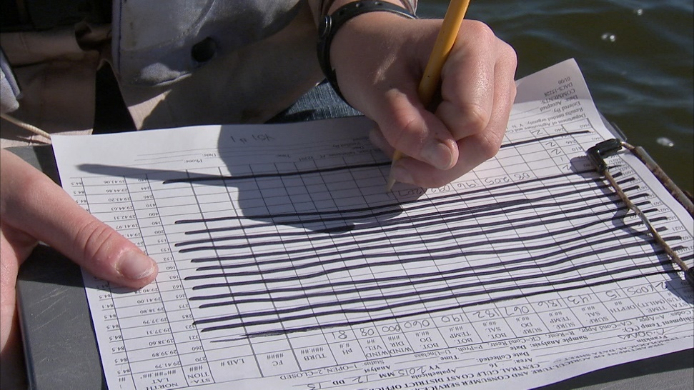
How do we monitor water quality?
Collect field parameters including salinity, temperature, D.O and pH
Sampling is scheduled to:
  1) Reopen areas and
  2) Sampling strategies established in the NSSP model ordinance
FL follows the Adverse pollution condition (APC) sampling strategy

Slide 12
Management plan of Duval County harvest area (pre-1994)
NOAA Jacksonville Beach Station
  RF5 ≥ 0.99 inches
USGS remote station at channel marker 67
  RF5 ≥ 0.99 inches and/or Salinity ≤ 26.3 ppt
1993 – The remote station was damaged and area was administratively closed.
Data Analysis (1994) revealed that all stations within harvest area did not meet approved or conditionally approved classification.
Resulting in area being reclassified to Prohibited January 1996.

Slide 13
Classification of Duval County harvest area (pre-1994)

Slide 14
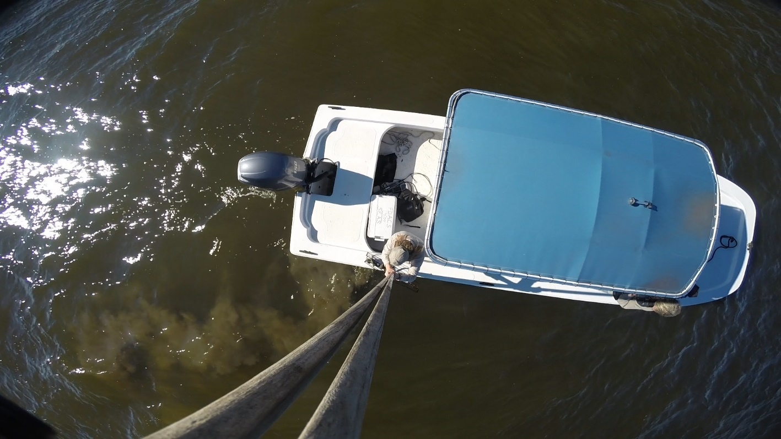
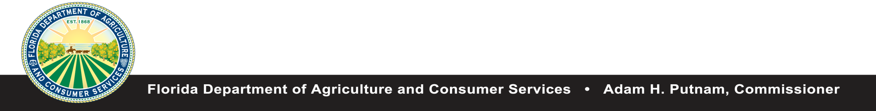
For Additional Information Contact the Division of Aquaculture
600 S Calhoun Street, Suite 217 Tallahassee, FL, 32399
850-617-7600 or
Visit the Division‘s website
http://www.freshfromflorida.com/Divisions-Offices/Aquaculture

